Slide 1
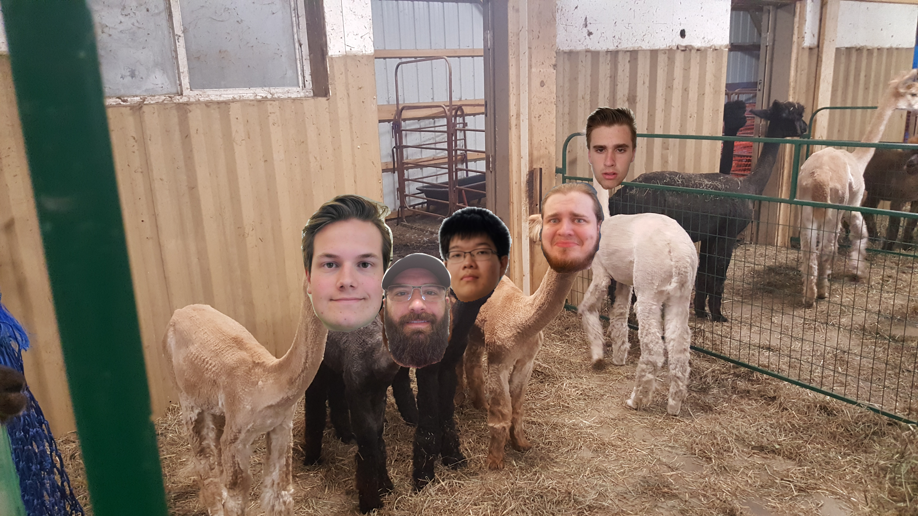
The Alpacas
Tucker Burke, Kevin Dolan, Nick Engell, Joseph Hong, Owen King
Notes:
Do remember to introduce your team members by name individually.

Slide 2
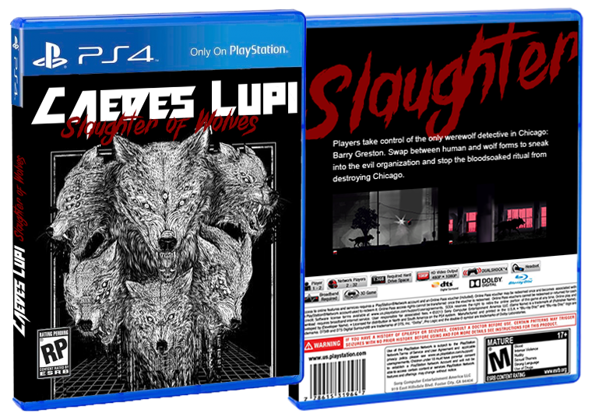
Caedes Lupi

Slide 3
Caedes Lupi Overview
A dark organization plans to perform a terrible ritual underneath Chicago...
Players take control of the only werewolf detective in Chicago: Barry Greston. Swap between human and wolf forms to sneak into the evil organization and stop the bloodsoaked ritual from destroying Chicago.

Slide 4
Walkthrough
Upon starting the game, players will be loaded into a level in which they begin in their human form
Players then use WASD to move and space to jump if human. If they are in their werewolf form, space is instead used to lunge and then attack with a mouse click. Players can press T to transform between human and werewolf forms
If killed the player can quickly restart with the R key
Notes:
Clearly describe your game so I know how the game is played

Slide 5
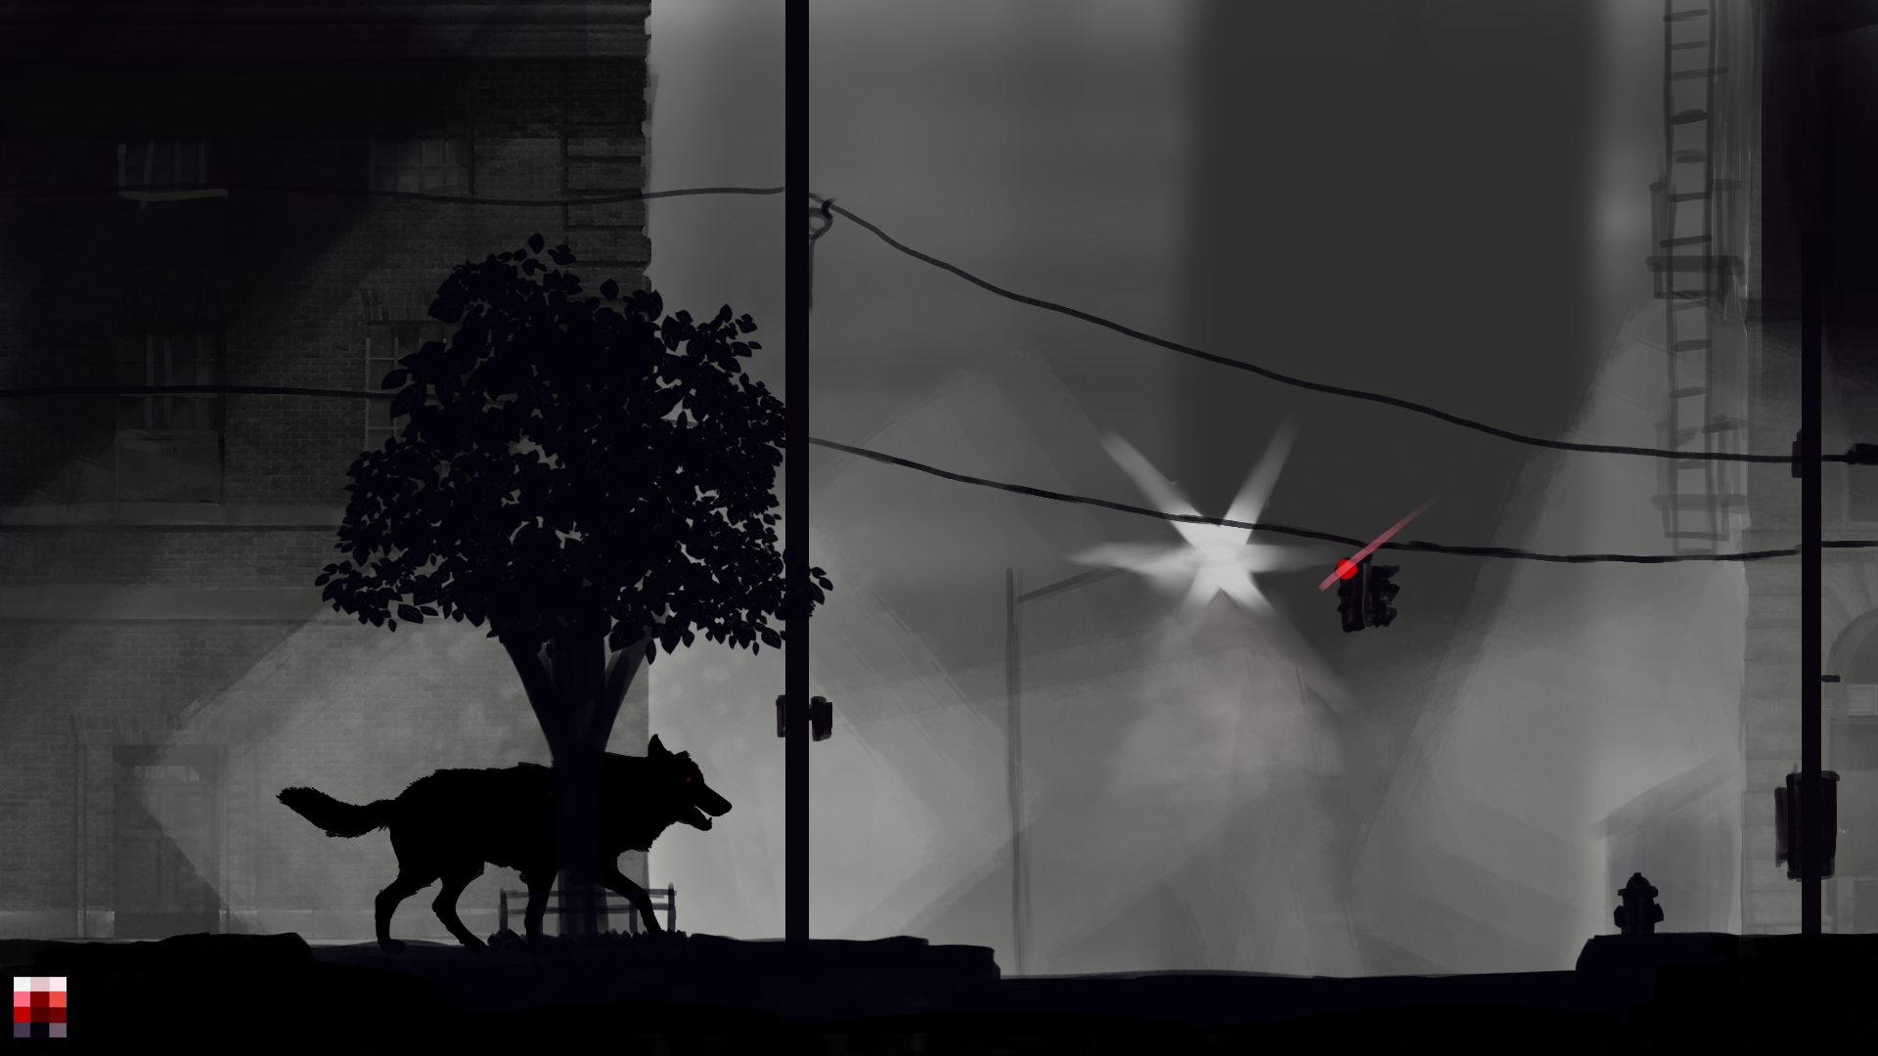
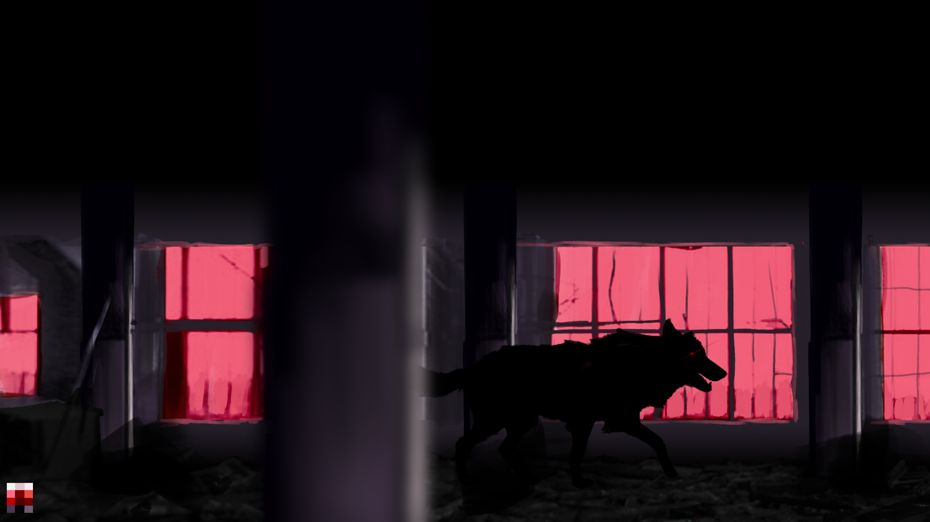
Concept shots
Game when you first
spawn.
Midway through a
level. Maybe during
a mid pounce/leap.

Slide 6
Strengths of Caedus Lupi
Quality animations and assets for the player and enemies
Better version control
Game has strong concept and potential, could be expanded on very easily
Learned a great deal
Notes:
Tucker was able to design a great and clean board with icons and placements for game components,along with a full deck of designed cards, as well as acquiring dubloon style metal coins and a small treasure chest to store the game currency in
One game mechanic changed the prices of item cards in region market after selling them. The table prices were clearly marked on the map and could be easily kept track of

Slide 7
Weaknesses of Caedus Lupi
Short game length
Overscoped complexity of features for limited time and energy left at end of semester
Went too “deep” rather than wide
Notes:
Due the fairly simplistic nature of the game, the player doesn't have many options in the way of interesting player choice or strategy
The rules often took far longer than anticipated to learn for new players, often taking around 20 to 30 mins to learn

Slide 8
Strengths of the Alpacas
Frequent communication
Wide range of skills amongst group members allowed for unique features
Evenly distributed workload

Slide 9
Weaknesses of the Alpacas
Overscoped for amount of time left in the semester, Was too ambitious on game mechanics
Came down to the wire, game was not finished until final days of semester
Periods of time where no significant progress was made

Slide 10
Future Development
Is this game worth further development? We believe so. Further refinement of game mechanics could lead to a very compelling project.
The takeaways from this project are:
Budgeting time to work on code is extremely important as it is often hard to predict how long it will take
Complicated solutions that seem good on paper are worse than simple solutions that work in practice
We make games!

